Slide 1
Léčba CRC na základě více či méně obvyklých biomarkerů
T. Svoboda

Slide 2
Okénko do historie
Terapeutické rozhodování včera, dnes a zítra

Slide 3
Otázka:
Má podávání cílené léčby u mCRC nějaký význam ?

Slide 4
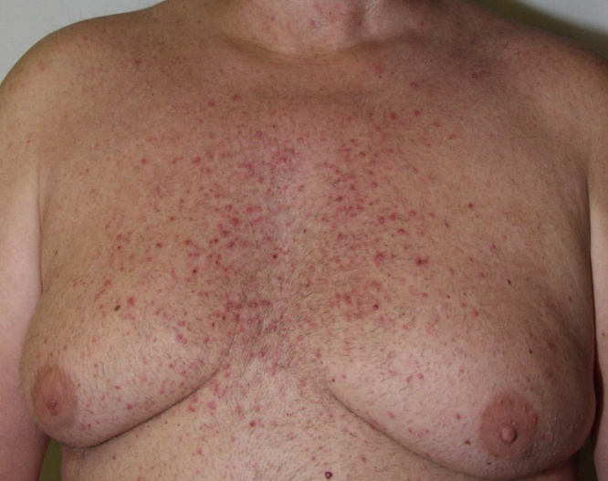
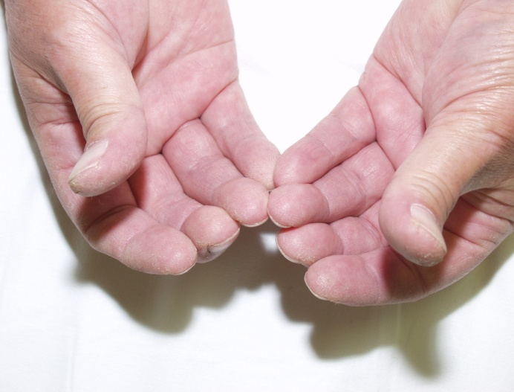
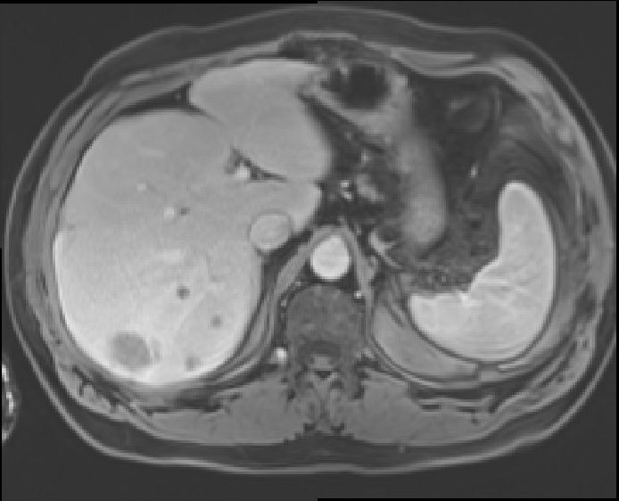
Kazuistika - charakteristika
2009-2010
Muž 57 let, KPS 90%
Adenokarcinom rektosigmatu, po resekci v 4/08 zjištěno stádium pT3pN1M0, G2, V0, L1, uzliny 1/21
CHT s oxali, pak meta jater po opakovaně měněných režimech, lokálně RFA+chemoembolizace, cíleně beva a později cetuximab
Jediným známým parametrem KRAS WT
Obr. MR jater se změnami po RFA a dalšími meta v okolí

Slide 5
Kazuistika – závěr 2009
Veškerá CHT bez efektu, vč. nových cytostatik
Jedinou látkou, na kterou pac. odpověděl, byl cetuximab
Při relapsu není jiná léčebná eventualita
Cílená léčba má bezpochyby v terapii meta KRK své místo, ale:
nevíme, jakým způsobem funguje (např. EGFR ne, KRAS asi ne –NORDIC VII.)
dokážeme identifikovat skupinu vhodných nemocných ?
nejsou k dispozici prediktivní faktory

Slide 6
Realita dnešních dní
Bioptické vyšetření 3.1.2024 14:51 Bioptická laboratoř Plzeń Primární vzorek: tkáň ve formolu
Vyšetření bylo zpracováno metodou v rozsahu akreditace dle SOP-01
Obdrželi jsme Vaši žádost o molekulárně genetické vyšetření, toto provedeme a výsledek sdělíme obratem. Genetické vyšetření č.24 319/2023
- Izolace nukleových kyselin Datum 21.12.2023.
Izolace RNA byla provedena kitem Maxwell RSC RNA FFPE. - FusionPlex Comprehensive Thyroid and Lung Kit (CTL)
Detekce fúzních transkriptů a mutací pomocí kitu FusionPlex CTL Archer DX (detekuje fúzní transkripty ve vybraných oblastech genů: ALK, AXL, BRAF, CCND1, EGFR, FGFR1, FGFR2, FGFR3, MET, NRG1, NTRK1, NTRK2, NTRK3, PPARG, RAF1, RET, ROS1, THADA a
mutace v hotspot oblastech genů: AKT1, ALK, BRAF, CTNNB1, DDR2, EGFR, ERBB2, FGFR1, GNAS, HRAS, IDH1, IDH2, KRAS, MAP2K1, NRAS, PIK3CA, RET, ROS1) akreditovanou metodou dle SOP 22.* (v případě mutací reportovány pouze patogenní a pravděpodobně patogenní varianty)
LOD pro fúzní transkripty: 3 unique starting sites, 5 unique reads. LOD pro varianty: 5%.
Ve vyšetřovaném vzorku NEPROKAZUJEME fúzi ani mutaci žádného z genů obsažených v kitu CTL.
- TruSight Oncology 500 Panel - DNA část
Detekce somatických mutací v klinicky relevantních oblastech 523 genů NGS kitem TruSight Oncology 500 (Illumina). Kit také umožňuje detekci amplifikace v 59 vybraných genech, mutační nálože (TMB) a mikrosatelitní nestability (MSI). Metoda akreditována dle SOP 22.* LOD: 5% (reportovány pouze patogenní/pravděpodobně patogenní varianty)
Ve vyšetřovaném vzorku NEPROKAZUJEME klinicky významné mutace.
Prokazujeme NÍZKOU mutační nálož - (TMB: Low; 0 mut/Mb).
Prokazujeme NÍZKOU mikrosatelitní nestabilitu (MSI-L; 1,37 % lokusů).
NEPROKAZUJEME klinicky významné amplifikace vyšetřovaných genech.

Slide 7
Guidelines ESMO 2014 (= ČOS)

Slide 10
Key Biomarkers in GI Cancers
Gastric and Esophageal
Biliary Tract
Pancreatic
Colorectal
Agnostic
MMR/MSI
FGFR fusion
BRCA1/2, PALB2
MMR/MSI
MMR/MSI
Actionable fusion, incl. NTRK, RET
HER2
IDH
DNA repair aberrations
RAS/RAF
TMB
PD-L1
HER2
BRAF V600E

Slide 11
What Influences Treatment Choices in mCRC?
Patient characteristics
Molecular characteristics
Comorbidities
Prior adjuvant treatment
RAS
BRAF
1L
MSI-high
HER2
Age
Performance status
2L
NTRK, RET, TMB
Tumor characteristics
3L
Patient preference
Tumor burden
Resectability
4L
Quality of life
Toxicity profile
Tumor location
Therapy tailored according to individual patient needs
Modified from Van Cutsem. Ann Oncol. 2016;27:1386.
Notes:
mCRC, metastatic colorectal cancer; MSI, microsatellite instability.

Slide 12
Guidelines for Biomarker-Based Treatment of mCRC
Biomarker-Defined Patient Subset | Incidence | Typical Regimens | Expected ORR
KRAS/NRAS/BRAF WT and left-sided | -- | Cetuximab Panitumumab Irinotecan + (cetuximab or panitumumab) | --
dMMR/MSI-H | 4%-5% | Pembrolizumab Nivolumab ± ipilimumab Dostarlimab | 45%-55%
HER2 amplified and RAS/BRAF WT | 2%-3% | Trastuzumab + (pertuzumab or lapatinib or tucatinib) Trastuzumab deruxtecan | 30%-50%
BRAF V600E | 7%-8% | Encorafenib + (cetuximab or panitumumab) | 20%
NTRK gene fusion | <0.5% | Larotrectinib Entrectinib | 57%-80%
RET gene fusion | <0.5% | Selpercatinib | 64%
NCCN. Clinical practice guidelines in oncology: colon cancer. v2.2023. nccn.org. Morris. JCO. 2023;41:678. Ohishi. Int J Molecular Sci. 2023;24:1702. Oaknin. J Immunother Cancer. 2022;10:e003777. Xie. Signal Transduct Target Ther. 2020;5:22. Hong. Lancet Oncol. 2020;21:531. Doebele. Lancet Oncol. 2020;21:271. Drilon. NEJM. 2020;383:813.

Slide 13
Preferred Subsequent Therapy Based on Molecular Profile
RAS/BRAF Wild-Type | RAS WT/BRAF V600E | MSI-H/dMMR | HER2+ | NTRK Fusion
EGFR-naive only Left-sided tumors only Chemotherapy + cetuximab or panitumumab | Encorafenib + cetuximab Encorafenib + panitumumab | ICI-naive only Nivolumab ± ipilimumab Pembrolizumab Dostarlimab | Trastuzumab + lapatinib, pertuzumab, or tucatinib Trastuzumab deruxtecan | Entrectinib Larotrectinib
Selpercatinib, a RET inhibitor, is a treatment option for patients with solid tumors that are RET gene fusion positive
Patients without actionable mutations or MSI-H/dMMR disease should receive standard chemotherapy ± bevacizumab (preferred) or other VEGF inhibitor (ziv-aflibercept, ramucirumab)
Type of chemotherapy dependent on previous regimen; retreatment after progression on a regimen other than bevacizumab is not recommended
Patients who have progressed through all standard lines of therapy may receive regorafenib or trifluridine + tipiracil ± bevacizumab (+ bevacizumab preferred)
NCCN. Clinical practice guidelines in oncology: colon cancer. v2.2023. nccn.org.
NCCN. Clinical practice guidelines in oncology: rectal cancer. v3.2023. nccn.org.
Notes:
dMMR, mismatch repair deficient; ICI, immune checkpoint inhibitor; MSI-H, microsatellite instability‒high.

Slide 14
Recent Data With HER2-Targeted Regimens for mCRC
Agent/Regimen | Key Trials | Key Findings
Trastuzumab + lapatinib | HERACLES HER2+ mCRC with PD after standard treatment (phase II; N = 35) | ORR: 28% (n = 1 CR; 9 PR) Median PFS: 4.7 mo Median OS: 10.0 mo
Trastuzumab + pertuzumab | MyPathway Basket Trial HER2+ mCRC refractory to standard treatment (phase II; N = 84) | ORR: 26.2% ORR w WT KRAS: 31% Median DoR: 5.9 mo
Tucatinib + trastuzumab | MOUNTAINEER For previously treated HER2+ mCRC (phase II; N = 84) | ORR: 38.1% Median PFS: 8.2 mo Median OS: 24.1 mo
Trastuzumab deruxtecan | DESTINY-CRC01 Advanced CRC of varied HER2 expression with ≥2 prior regimens (phase II; N = 78) | ORR: 45.3% if HER2 IHC 3+ Median PFS: 6.9 mo Median OS: 15.5 mo
Tucatinib now approved in combination with trastuzumab for RAS wild-type HER2-positive unresectable or metastatic CRC that has progressed following treatment with fluoropyrimidine-, oxaliplatin-, and irinotecan-based chemotherapy
All 4 regimens above are listed in national guidelines as options after ≥1 line of prior therapy if intensive therapy possible
Meric-Bernstam. JCO. 2021;39:Abstr 3004. Siena. Lancet Oncol. 2021;22:779. Strickler. Lancet Oncol. 2023;24:496. Tosi. Clin Colorectal Cancer. 2020;19:256. Yoshino. JCO. 2022;40:Abstr. 119. Tucatinib PI.
Notes:
CR, complete response; CRC, colorectal cancer; DoR, duration of response; GEJ, gastroesophageal junction; GI, gastrointestinal; IHC, immunohistochemistry; mCRC, metastatic colorectal cancer; ORR, overall response rate; OS, overall survival; PFS, progression-free survival; PR, partial response.

Slide 15
NTRK Gene Fusions in GI Cancers: Rare but Actionable
Treatment | Tumor FDA Agnostic Indication
Larotrectinib | Adult/pediatric patients with solid tumors with a NTRK gene fusion without a known acquired resistance mutation who are either metastatic or not candidates for surgical resection due to likely severe morbidity and who have no satisfactory alternative treatments or PD following treatment
Entrectinib | Adult/pediatric patients (≥12 yr of age) with solid tumors with a NTRK gene fusion without a known acquired resistance mutation who are either metastatic or not candidates for surgical resection due to likely severe morbidity and who have no satisfactory alternative treatments PD following treatment
NTRK gene fusions and TRK fusion chimeric proteins occur in <5% of GI cancers
Larotrectinib PI. Entrectinib PI.
Notes:
CRC, colorectal cancer; GI, gastrointestinal; GIST, gastrointestinal stromal tumor; PD, progressive disease.

Slide 16
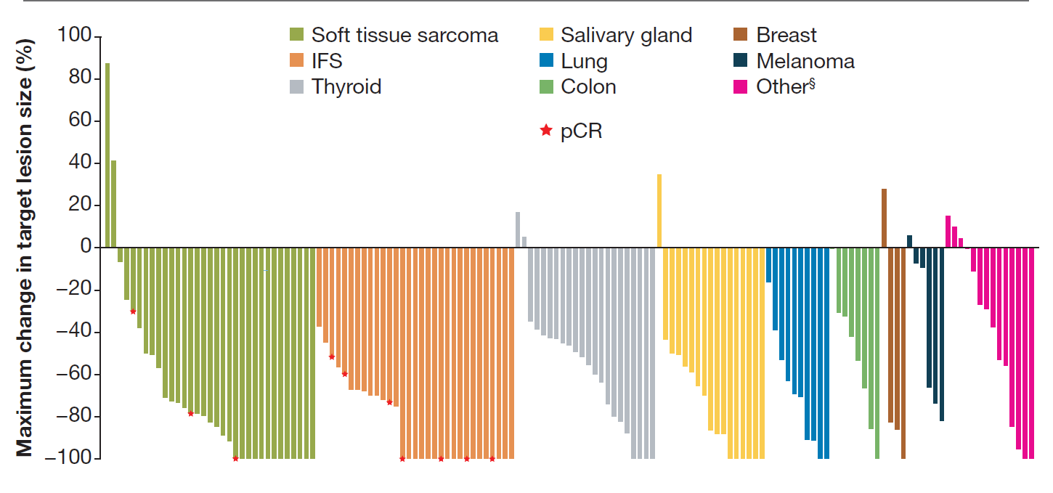
Larotrectinib in NTRK Fusion–Positive Cancers
Analysis of 3 open-label trials (phase I or II trials in adults) assessing entrectinib for treating advanced solid tumors with NTRK gene fusion
100
Antitumor Activity (n = 159)*
80
Soft tissue sarcoma
Salivary gland
Breast
60
Infantile fibrosarcoma
Lung
Melanoma
40
Thyroid
Colon
Other
20
pCR
Maximum Change in
Target Lesion Size (%)
0
-20
-40
-60
Median follow-up: 35.8 mo.
-80
*n = 5 without measurable lesions assessed by IRC.
-100
Efficacy (N = 164): ORR, 74%; median DoR, 35 mo; median PFS, 32 mo
Ongoing phase II NAVIGATE study in advanced solid tumors with NTRK fusions (NCT02576431)
McDermott. ESMO 2022. Abstr 463P.
Notes:
DoR, duration of response; IRC, independent review committee; ORR, overall response rate; pCR, pathologic complete response; PFS, progression-free survival.

Slide 17
Targeting “Undruggable”: KRAS G12C Inhibitors for Advanced GI Cancers
Agent | Previous Data | Previous Data |  | Key Ongoing Trials
 | Trial/Population | Combination | ORR (%) | Trial
Sotorasib | CodeBreaK100 (phase I/II): previously treated KRAS G12C–mutated CRC | None | 9.7 | CodeBreak 300 (phase III, NCT05198934): sotorasib + panitumumab vs TAS-102 or regorafenib; previously treated KRAS G12C–mutated mCRC
 | CodeBreaK101 (phase Ib): previously treated advanced KRAS G12C–mutated CRC | Panitumumab | 16.7
 | CodeBreaK100: previously treated KRAS G12C–mutated pancreatic cancer | None | 21
Adagrasib | KRYSTAL-1 (phase I/II): KRAS G12C–mutated CRC | ± cetuximab | Monotherapy 22, + cetuximab 43 | KRYSTAL-10 (phase III, NCT04793958): adagrasib + cetuximab vs CT for previously treated KRAS G12C–mutated mCRC
 | KRYSTAL-1: KRAS G12C–mutated pancreatic cancer | None | 50
Fakih. Lancet Oncol. 2022;23:115. Fakih. ESMO 2021. Abstr 434P. Weiss. ESMO 2021. Abstr LBA6. Bekaii-Saab. ASCO GI 2022. Abstr 519.
Notes:
CRC, colorectal cancer; CT, chemotherapy; ORR, overall response rate.

Slide 18
Locally Advanced Rectal Cancer
Usual treatment for locally advanced rectal cancer includes neoadjuvant chemotherapy and radiation followed by surgical resection
Based on data in metastatic setting, could checkpoint inhibition be effective in locally advanced dMMR rectal cancer?
Cercek. NEJM. 2022;386:2363.

Slide 19
Neoadjuvant Dostarlimab ± standard CRT and surgery in dMMR Stage II-III Rectal Cancer
Prospective, nonrandomized, open-label phase II trial (median follow-up: 12 mo)
cCR
Nonoperative follow-up
Adults with dMMR* stage II-III rectal cancer; ECOG 0/1
(N = 16)
Dostarlimab
500 mg IV Q3W x 9
RT with total dose of 5040 cGy in 28 fractions + concurrent capecitabine at standard doses
Total mesorectal excision
No cCR
*Determined by IHC for loss of expression of MLH1, MSH1, MSH6, and PMS2.
Primary endpoints: sustained pCR or cCR at 12 mo
Cercek. NEJM. 2022;386:2363. NCT04165772.

Slide 20
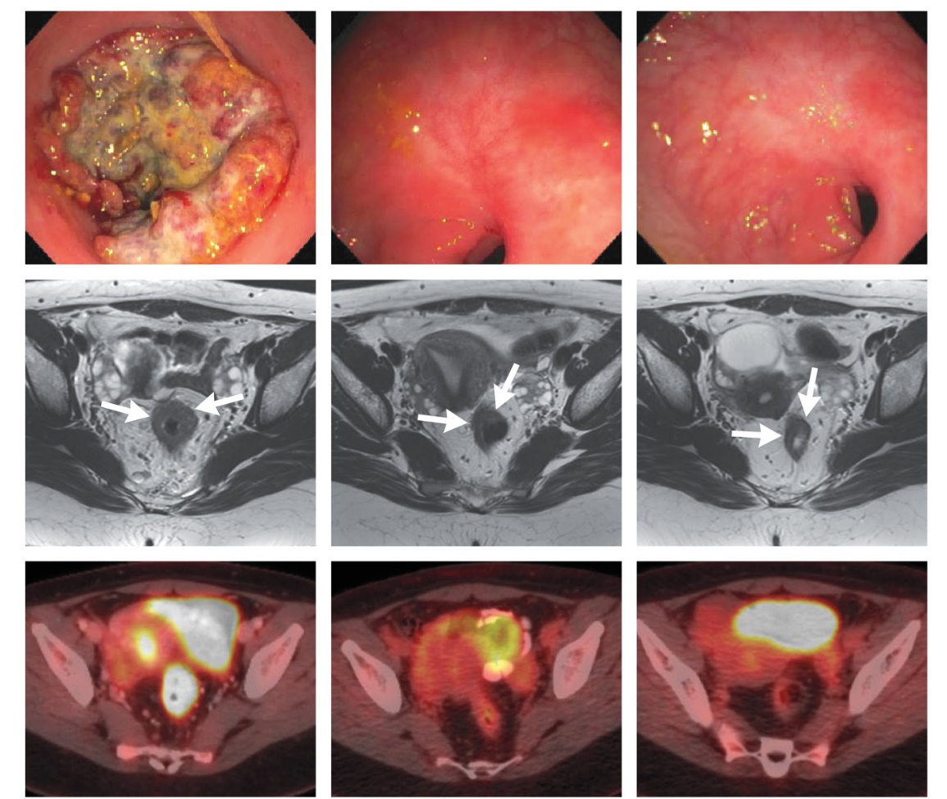
Neoadjuvant Dostarlimab ± Standard CRT and Surgery in dMMR Stage II-III Rectal Cancer: Outcomes
Patient With Endoscopic CR and Near-CR on Rectal MRI at 3 Mo, cCR at 6 Mo
BL
3 Mo
6 Mo
12/16 patients have completed treatment with ≥6 mo follow-up
cCR rate: 100%
No evidence of tumor on MRI, PET, and endoscopy
None received CRT or underwent surgery
No PD or recurrence during follow-up (range: 6-25 mo)
No grade ≥3 AEs reported
Endoscopy
Rectal MRI
FDG-PET
Cercek. NEJM. 2022;386:2363.

Slide 21
NICHE-2: Neoadjuvant Nivolumab ± Ipilimumab in Locally Advanced dMMR Colon Cancer
Multicenter, nonrandomized, investigator-initiated trial in The Netherlands
Patients with previously untreated, nonmetastatic dMMR colon adenocarcinoma; cT3 and/or N+ per radiologic staging*; no clinical signs of obstruction; no clinical symptoms/radiologic suspicion of perforation
(N = 112)
6 wk
Nivo 3 mg/kg +
Ipi 1 mg/kg
Nivo 3 mg/kg
Surgery
Tissue, plasma, and PBMC
Plasma and PBCM
Tissue, plasma, and PBMC
Plasma and PBCM (follow-up)
*Protocol revision (October 2020) added new cohort (n = 70) with ≥T3 and/or N+ tumors along with primary endpoint of 3-yr DFS.
Baseline radiologic assessment revealed 88% stage III, 74% high-risk stage III, 63% T4 tumors
Coprimary endpoints: safety, 3-yr DFS
Secondary endpoints included: pCR rate (0% residual viable tumor in primary tumor bed and LN), MPR rate (≤10% residual viable tumor, residual tumor in LN allowed) in post-tx surgical specimen
Chalabi. ESMO 2022. Abstr LBA7.

Slide 22
NICHE-2: Outcomes
No disease recurrence at median f/u of 13 mo (range: 1.4-57.4)
Grade 3/4 irAEs: 4%
3 patients had delay in surgery with 98% undergoing timely surgery (safety primary endpoint met*)
Pathologic Response, % | n = 107
Yes (≤50%) Major (≤10%) Complete (0%) Partial (10% to 50%) | 99 95 67 4
No (≥50%) | 1
Anti-tumor Activity
0
-20
-40
Pathologic Tumor Regression (%)
PR
-60
-80
MPR
-100
Chalabi. ESMO 2022. Abstr LBA7.
*Safety endpoint met if 95% underwent timely surgery (<2-wk delay).

Slide 23
